Slide 1
rtos
Basics

Slide 2
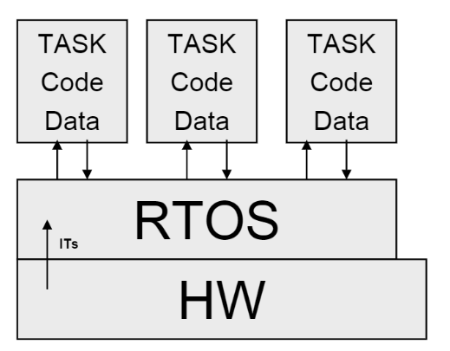
RTOS: Components
Kernel
System resource manager
Includes the Scheduler
Schedules tasks for execution
Task
Implements specific task code
Has its own ‘state’ / ‘context’
PC, Registers, Stack, etc.
ISRs
Interrupt service routines
Layering starts!
Tasks have to go through the RTOS
To interact with HW!

Slide 3
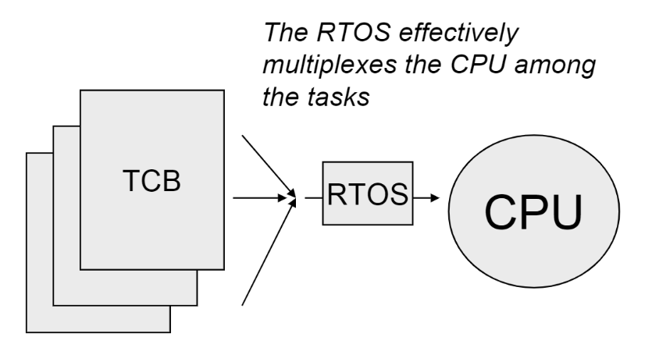
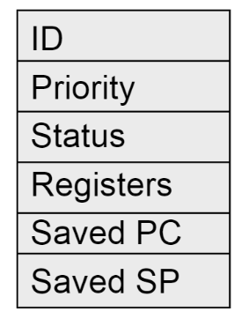
RTOS: Task structure
Task is composed of:
Task code: Implementing function
Task data: Variables local to the task
Task ‘state’ / ‘context’: What the task is doing
Task Control Block (TCB)
A data structure storing task properties
When Task is not running
Unique per task
Typical TCB structure:

Slide 4
RTOS: Task state / status
Executing
Running on the CPU
Ready
Could run, but can’t since another is running on the CPU
Blocked
Cannot run, waiting for some resource to be available
Dormant
Created, but not ready to run yet
Terminated
No longer active
RTOS implements an FSM for each task
Manages task state transitions

Slide 5
RTOS: Task state machine
Task just created
Dormant
Task scheduled
Task active
Task activated
Ready
Task yields
Executing
Task waiting
Task got resrc
Task killed
Blocked
Task got resrc
Task killed
Terminated

Slide 6
RTOS: Scheduler
The RTOS Scheduler
Implements the task state machine
Maintains a list of tasks in 2 states
Executing
Ready
Other states don’t matter much
Blocked task has to unblock itself
Dormant task has to be activated
Terminated task is anyway dead
Switches between tasks
Context switch algorithm
Save current task’s context into its TCB
Find new task to run
Restore context from its TCB
Run new task

Slide 7
RTOS: Task/context switching options
A task/context switch in an RTOS could be:
Non-preemptive (Cooperative)
Passive Scheduler
A running / executing task keeps running till:
It yields CPU time voluntarily
It gets blocked on some unavailable resource
Depends on the good behavior of all tasks
Rarely used in today’s systems
Preemptive
Proactive Scheduler
Scheduler switches tasks abruptly due to:
A time slice expiry (for equal priority scenarios)
A higher priority task / event (interrupt)

Slide 8
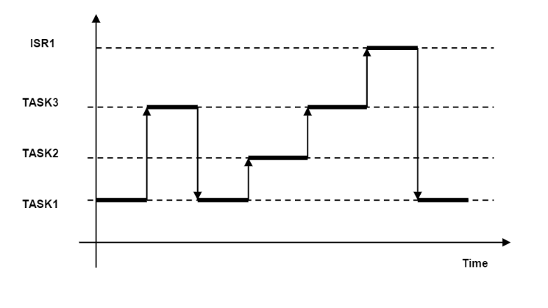
RTOS: Preemptive scheduler functioning
System with 3 tasks
Task1, Task2, Task3, and 1 interrupt (handled by ISR1)
Priority wise:
ISR1 > P(Task3) > P(Task2) > P(Task1)
Scheduler runs highest priority task
Lower priority task is ‘suspended’
Lower priority task ‘resumes’ run
After higher priority task is done
ISR1 is at highest priority
It suspends any and all tasks to run
Sample RTOS trace

Slide 9
RTOS: Resource management
Embedded systems are (severely) resource limited
Multiple tasks have to share resources
Each resource sharing creates its own issues
RTOS has its own way of mitigation
Resource | Issue | Mitigation
CPU time | Contention - All tasks want to run now! | Preemption, Time-slicing, Priority execution
Data (global) | Shared data problem | Mutual exclusion flags
Task code | Shared code problem | Function reentrancy
Hardware (pin, register, bus) | Contention and usage conflict | Mutexes, Semaphores

Slide 10
RTOS: Shared code problem
2 equal priority tasks – share code and data
int tmp; // shared global variable
Task 1 (use sensors 1,2)
Task 2 (use sensors 3,4)
// Sensor1=10 ⇒ Sensor2=10
void task (int sen1, int sen2)
{
tmp = read(sen1);
write(sen2) = tmp;
}
// Sensor3=20 ⇒ Sensor4=20
void task (int sen1, int sen2)
{
tmp = read(sen1);
write(sen2) = tmp;
}
task() is called non-reentrant

Slide 11
RTOS: Reentrancy
RTOS Scheduler keeps switching tasks
Depending on various policies and conditions
Time slice expiry
Priority pre-emption
Interrupt servicing
One/more of the above!
Hence, all task (as well as other) functions
Need to be reentrant
Reentrancy
Multiple invocations can safely run concurrently
System behavior does not change if a function is reentered
Any number of times from any number of points
Reentrant functions
Should not use globals
Should not call any non-reentrant functions

Slide 12
RTOS: Semaphore
Semaphore
A variable or data-type used to control access
To a common resource
By multiple tasks / threads / processes
In a concurrent system (like an OS/RTOS)
Types:
Counting semaphore
Supports arbitrary resource count
Used for controlled access to a pool of resources
Binary semaphore
Supports binary access (available / unavailable)
Used for controlled access to a single resource

Slide 13
RTOS: Mutex
Mutex
A locking mechanism used to control access
To a single resource
By multiple tasks / threads / processes
In a concurrent system (like an OS/RTOS)
Behaves very much like a binary semaphore
Implements mutual exclusion concurrency
Has concept of ownership
Only the task / thread that locked it can unlock it
In both mutex and semaphore
A task wanting to use an unavailable resource
Has to wait – go to a ‘blocked’ state

Slide 14
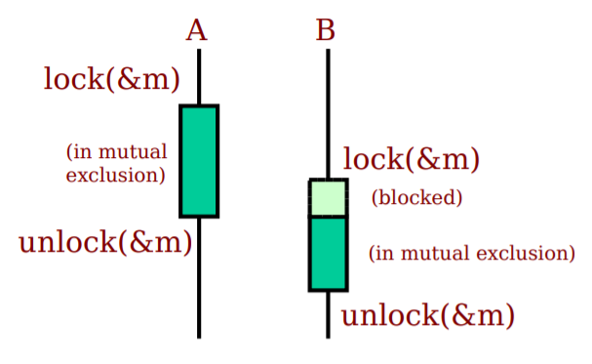
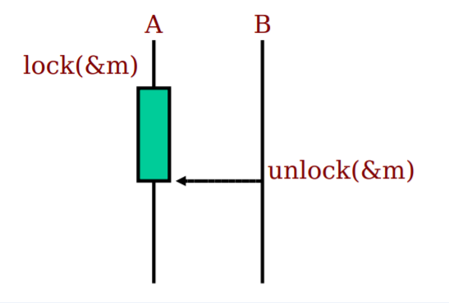
RTOS: Mutex vs Semaphore
Mutex
Semaphore

Slide 15
RTOS: Scheduling policies
Some policies used for scheduling task execution
Round-robin (RR)
All tasks at same priority
CPU time is sliced across different tasks
Called ‘fair’ scheduling
Fixed priority – Rate monotonic (RM)
Priority preemptive kernel
Set of periodic tasks
Tasks with shorter periods are given higher priority
Dynamic priority – Earliest deadline first (EDF)
Priority preemptive kernel
Ready task with earliest deadline has highest priority

Slide 16
RTOS: Memory management
No! (DO-178B)
All memory usage needs to be decided upfront
Dynamic memory allocation
Through standard C functions: malloc() / calloc() / free()
Severely restricted, if at all available
Dynamic memory involves heap management
Increases response ‘jitter’
RTOS memory management technique: Pools
Divide available memory into equal-sized pools
Run a restricted pool manager

Slide 17
Priority inversion

Slide 18
RTOS issue: Priority inversion – Case
Mars Sojourner Pathfinder (1996)
Wind River System’s VxWorks RTOS based rover
Worked well for a while on landing and deployment on Mars
Later, suspicious hang-ups and reboots started
Glitches had been observed during ground testing
Engineers attributed it to faulty hardware
Analysis revealed task restarts due to watchdog timer expiry
Frequent resets hampered its ability to collect critical data
Lifetime of the spacecraft was limited – leading to lost time-cycles
The problem was identified to a software failure
A high priority task on the system was blocked from running
While a lower priority task ended up consuming CPU

Slide 19
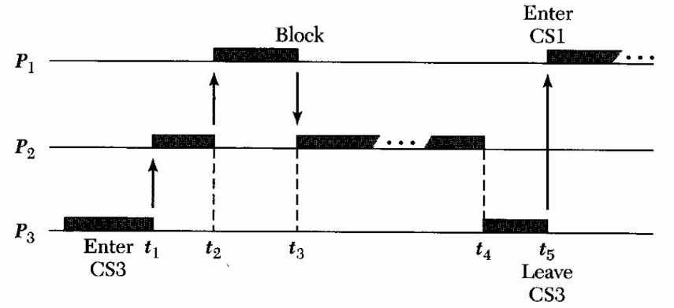
RTOS: Priority inversion – Root cause
Pathfinder System:
Tasks: Task1, Task2, Task3
1 shared resource, locked by mutex-lock S
Priorities: P1> P2 > P3
Task code template (CS indicates critical section):
Task1: { … lock(S); CS1(); unlock(S); … }
Task2: { … … … }
Task3: { … lock(S); CS3(); unlock(S); … }
Priority inversion – P2 trumps P1

Slide 20
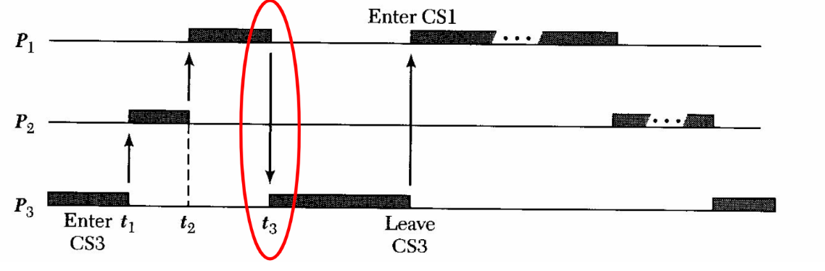
RTOS: Priority inversion – solution.1
Priority Inheritance Protocol (PIP)
Temporarily raise the priority of a low priority task
But only if it is blocking a high priority task
On leaving the CS, the priority reverts back to normal (low)
Low priority task thus inherits the priority of the high priority task

Slide 21
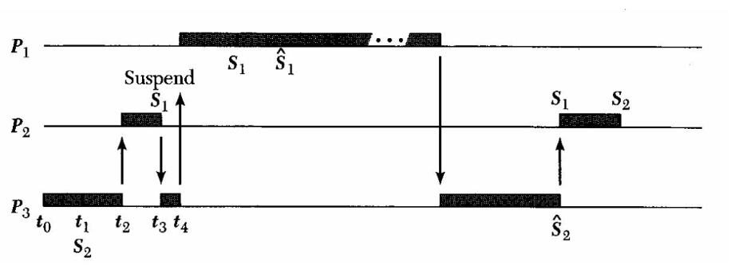
RTOS: Priority inversion – solution.2
Priority Ceiling Protocol (PCP)
Priority ceiling [PC(S)]: Highest priority of all tasks that use S
Rule: Task P trying to lock S will be suspended
Unless pri(P) > PC(S) for all S currently locked by other tasks
Example: 3 tasks (P1, P2, P3), 2 locks (S1, S2)
Assume: S1 is used by P1 and P2, S2 is used by P2 and P3
PC(S1) = max[pri(P1), pri(P2)] = pri(P1)
PC(S2) = max[pri(P2), pri(P3)] = pri(P2)
P3 gets ceiling of S2

Slide 22
RTOS: PCP vs PIP
PCP vs PIP
Relationship
PCP is considered to be a super-set of PIP
Incorporates more checks and conditions
Behavior
PIP is bad at handling chain blocking and race conditions
PCP handles chain blocking well
PCP minimizes inheritance related inversions
Blocking time is deterministic in PCP*
Scalability
PCP is considered more scalable compared to PIP
Implementation
PIP is easier to implement – less complex code
PCP is much more complicated to implement and debug

Slide 23
Thank you!

